Slide 1
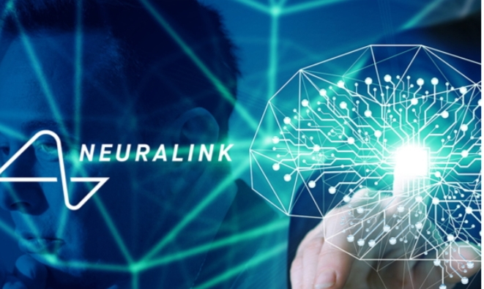
By
LAVANYA E
Notes:
By
Lavanya E

Slide 2
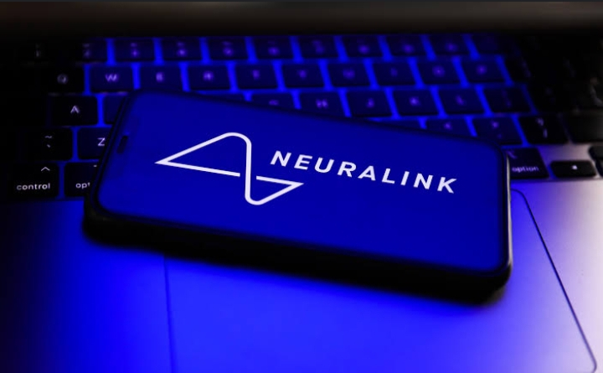
INTROUDTION OF NEUROLINK:
NEURA Link is a NEURA Technology company founded by Elon Musk in 2016. The company aims to develop implantable brain-machine interfaces(BMIs) that can help treat various neurological conditions enhance human cognitive abilities.

Slide 3
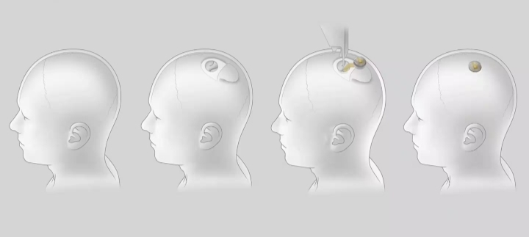
What is NEURA link?
NEURA link is a device , specifically , a BMI Interface , that will be surgically implanted into your mind and with it , you’ll be able to communicate with machines and even control them.

Slide 4
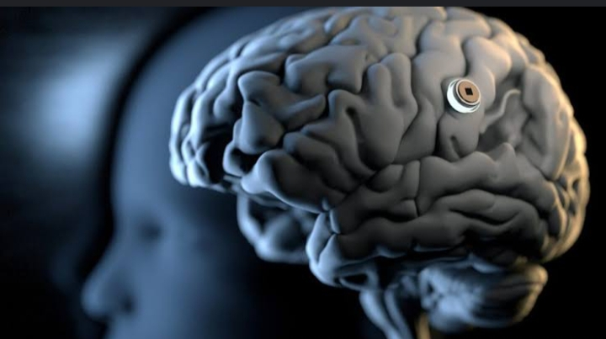
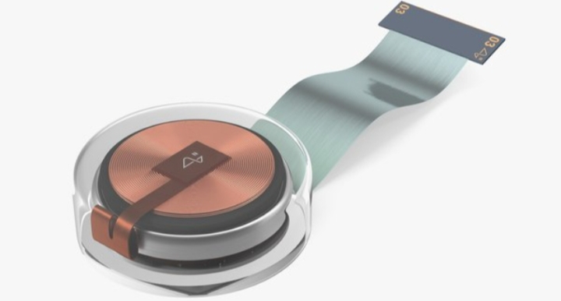
N1 CHIP
1024 channels per link
23 mm * 8 mm
Flush with skull
6-axis IMU , temperature , pressure
Megabit wireless data rate , post compression
All day battery life

Slide 5
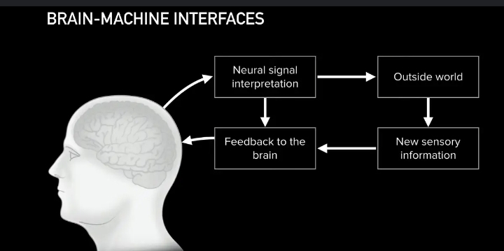
WORKING
Principle of Brain machine Interface
Neurons communicate with each other by sending and receiving very small electrical signals , these signals can be heard with advanced electrical sensors.
Signal processing has,
Pre processing
Feature extraction and
Feature translation

Slide 6
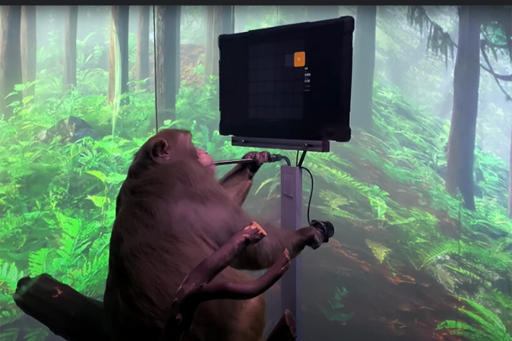
DEMO OF WORKING
As of now, the technology has not been tested on humans but it has tested on 19 different animals with robot.
It has success rate of 87% on animals
The first live specimens to have undergone a symbiosis have been a rat and a monkey, and pig.

Slide 7
ADVANTAGES
Improved Medical treatments
Enhanced cognitive abilities
Improved human-Computer interaction
New forms of communication
Advancements in artificial intelligence

Slide 8
DISADVANTAGES
Privacy concerns
Ethical concerns
Safety risks
Access and equity
Unintended consequences

Slide 9
CONCLUSION
Neuralink has developed advanced solution to existing medical problems.
It will surely create a well aligned future.
Implantation will be done in less than a hour.
Neuralink is still at an early stage.
It is concluded that Neuralink is the future for humans to live a safe, healthy and a prouductive life.

Slide 10


